Slide 1

6th Grade Math
Unit 12, Lesson 2 Finding an Unknown Fraction in an Equation Volume 2, pg. 287

Slide 2


Benchmark
MA.6.AR.2.4
Determine the unknown decimal or fraction in an equation involving any of the four operations, relating three numbers, with the unknown in any position.
volume 2, pg. 287

Slide 3
Integrated Mathematical Thinking and Reasoning Standards
MA.K12.MTR.1.1 Actively participate in effortful learning both individually and collectively.
MA.K12.MTR.2.1 Demonstrate understanding by representing problems in multiple ways.
MA.K12.MTR.4.1 Engage in discussions that reflect on the mathematical thinking of self and others.
MA.K12.MTR.5.1 Use patterns and structure to help understand and connect mathematical concepts.
volume 2, pg. 287

Slide 4

Learning Target
I can determine an unknown fraction in a numeric equation with three numbers.
volume 2, pg. 287

Slide 5

Warm-Up
volume 2, pg. 287

Slide 6
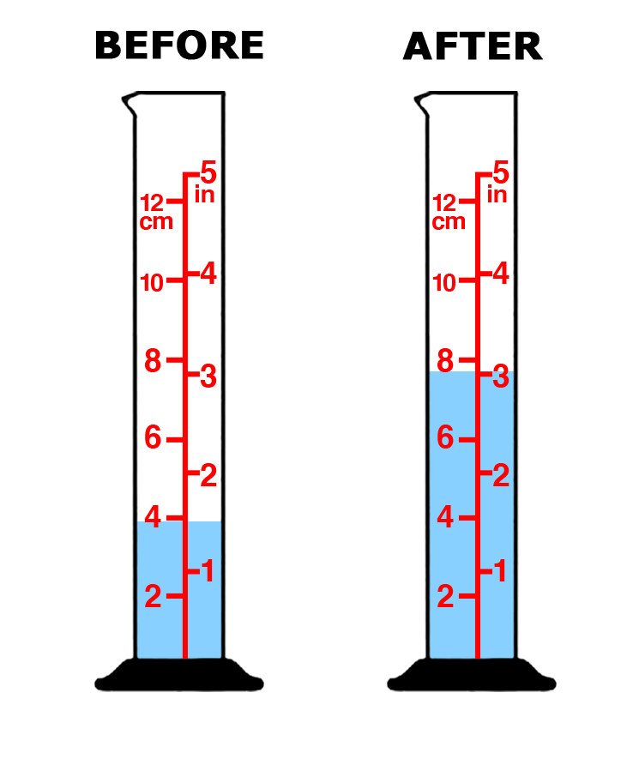
12.2.1 Warm-Up: How Much Rain?
José checked his rain gauge before and after a rain shower.
How much rain fell during the rain shower?
volume 2, pg. 287

Slide 7
Use the pictures to describe how you determined the amount of rain that fell during the rain shower.
volume 2, pg. 287

Slide 8

Guided Instruction
volume 2, pg. 288

Slide 9

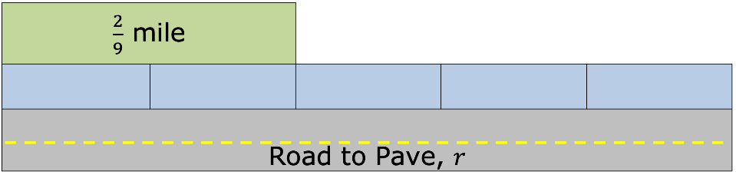
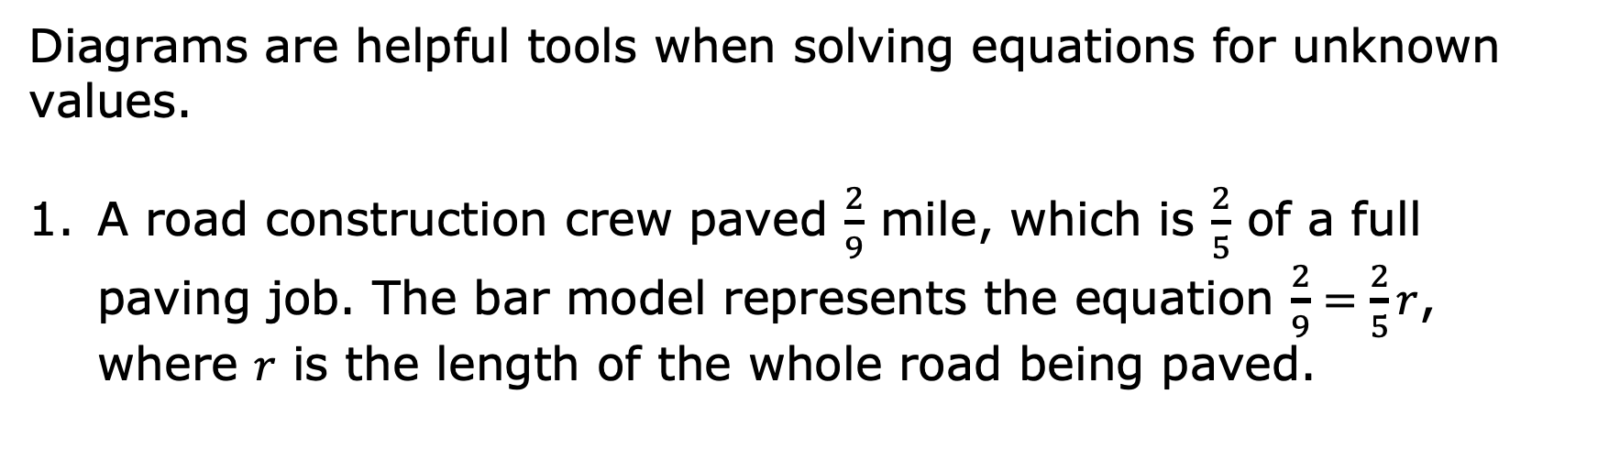
12.2.2 Guided Instruction: Using Diagrams to Solve Equations with Fractions
Diagrams are helpful tools when solving equations for unknown values.
A road construction crew paved $\frac{2}{9}$ mile, which is $\frac{2}{5}$ of a full paving job. The bar model represents the equation $\frac{2}{9}=\frac{2}{5}r$, where 𝑟 is the length of the whole road being paved.
volume 2, pg. 288

Slide 10
Discuss with your partner how the diagram represents the information given.
Describe how to use the bar model to solve the equation for 𝑟, the length of the road being paved.
volume 2, pg. 288

Slide 11

How long is the road being paved?
Check your solution. $\frac{2}{9}=\frac{2}{5} \left(\frac{ }{ }\right)$
volume 2, pg. 288

Slide 12
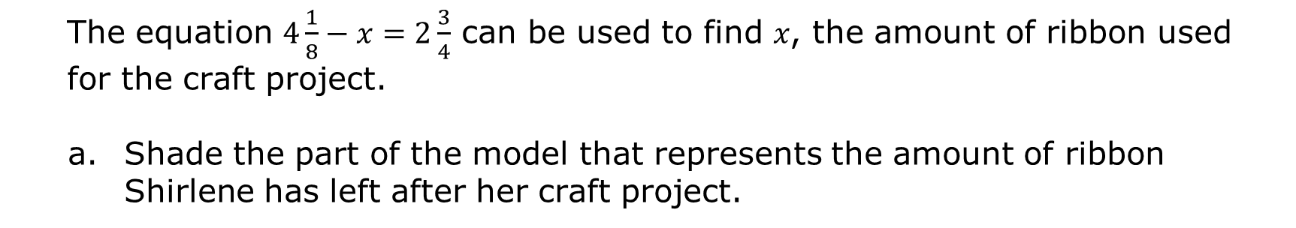
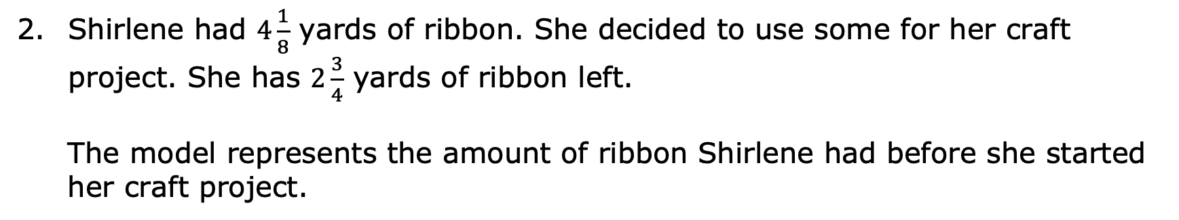
Shirlene had $4\frac{1}{8}$ yards of ribbon. She decided to use some for her craft project. She has $2\frac{3}{4}$ yards of ribbon left.
The model represents the amount of ribbon Shirlene had before she started her craft project.
The equation $4\frac{1}{8}−x=2\frac{3}{4}$ can be used to find 𝑥, the amount of ribbon used for the craft project.
Shade the part of the model that represents the amount of ribbon Shirlene has left after her craft project.
volume 2, pg. 288

Slide 13
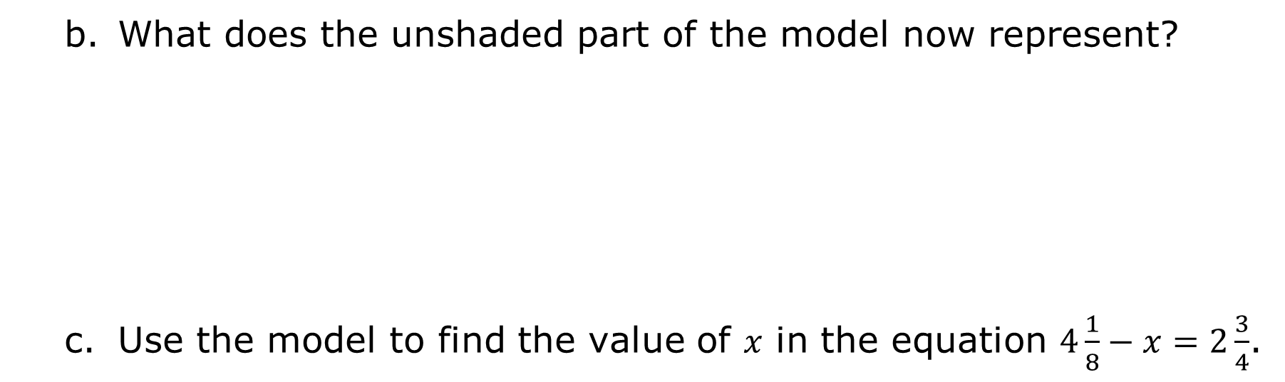
What does the unshaded part of the model now represent?
Use the model to find the value of 𝑥 in the equation $4\frac{1}{8}−x=2\frac{3}{4}$.
volume 2, pg. 289

Slide 14

How much ribbon did she use for the craft project?
Check your solution. $4\frac{1}{8} −$ $=2\frac{3}{4}$
volume 2, pg. 289

Slide 15
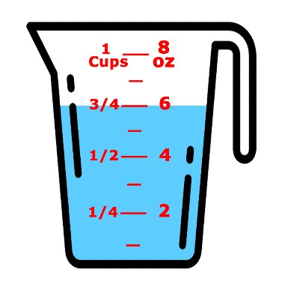
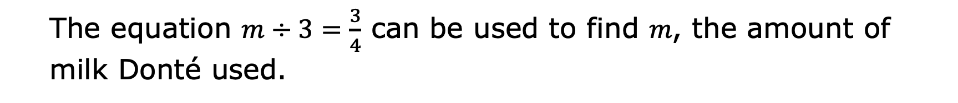
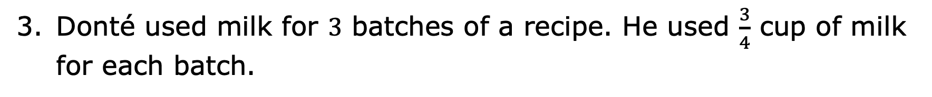
Donté used milk for $3$ batches of a recipe. He used $\frac{3}{4}$ cup of milk for each batch.
The equation $m÷3=\frac{3}{4}$ can be used to find 𝑚, the amount of milk Donté used.
volume 2, pg. 289

Slide 16
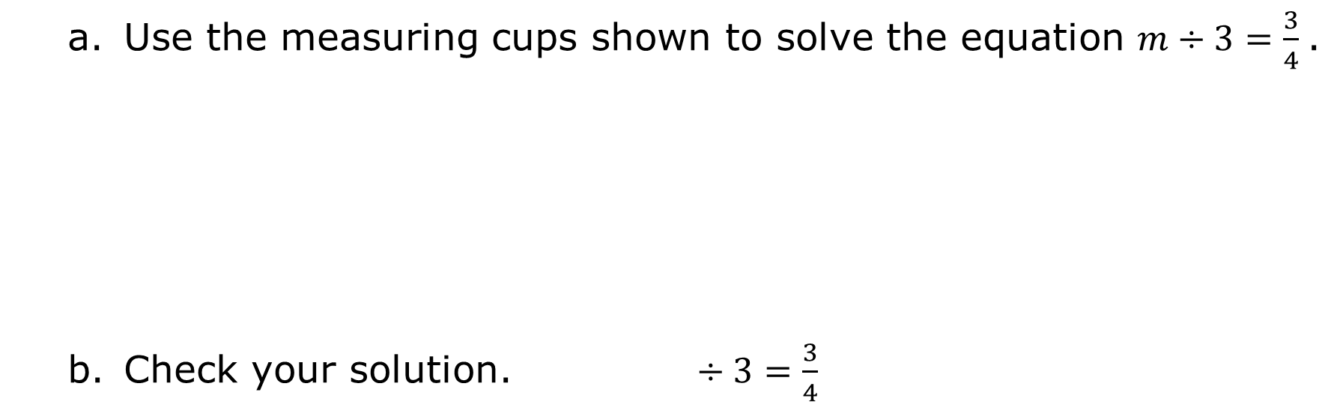
Use the measuring cups shown to solve the equation $m÷3=\frac{3}{4}$.
Check your solution. $÷3=\frac{3}{4}$
volume 2, pg. 289

Slide 17

Collaboration
volume 2, pg. 290

Slide 18

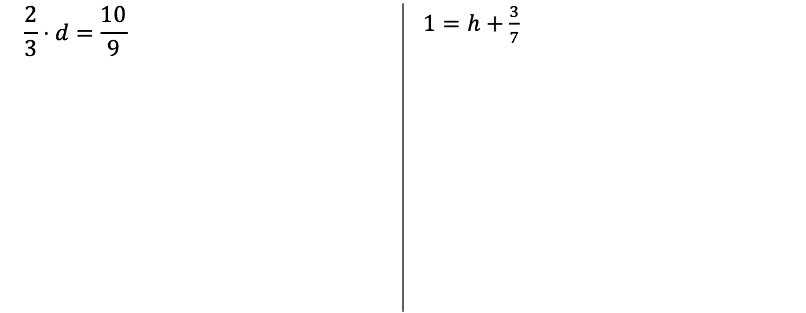
12.2.3 Collaboration: Solving Equations with Fractions Using Reasoning and Mental Math
Solve each equation. Check each of your solutions.
$$\frac{2}{3}⋅d=\frac{10}{9}$$ | $1=h+\frac{3}{7}$
volume 2, pg. 290

Slide 19
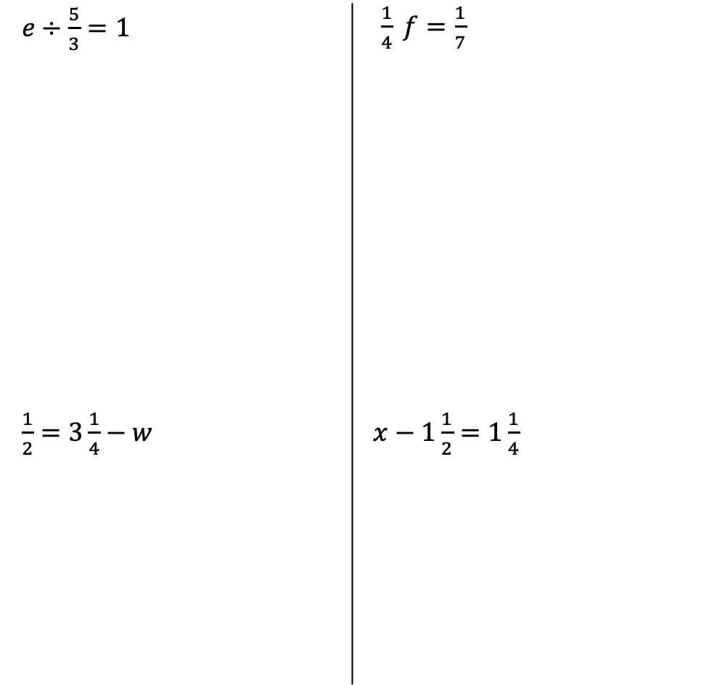
$e÷\frac{5}{3}=1$ | $\frac{1}{4} f=\frac{1}{7}$
$\frac{1}{2}=3\frac{1}{4}−w$ | $x−1\frac{1}{2}=1\frac{1}{4}$
volume 2, pg. 290

Slide 20
Some of the equations have equivalent solutions. Ask two classmates for a pair of equations that have equivalent solutions. In the table, record their solution and write the equations they tell you gave them that solution. You are the only person who should write in the first two columns of the table. Have the person initial next to the equations they told you have equivalent solutions.
Solution | Equations | Initials
volume 2, pg. 290

Slide 21

Guided Practice
volume 2, pg. 291

Slide 22

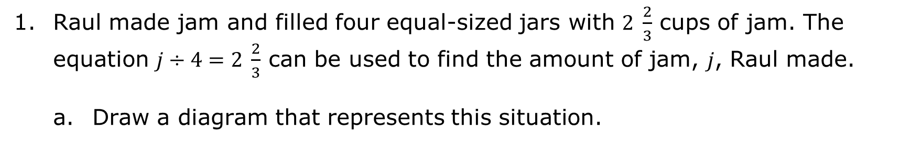
12.2.4 Guided Practice: Solving Equations with Fractions
Raul made jam and filled four equal-sized jars with $2 \frac{2}{3}$ cups of jam. The equation $j÷4=2 \frac{2}{3}$ can be used to find the amount of jam, 𝑗, Raul made.
Draw a diagram that represents this situation.
volume 2, pg. 291

Slide 23

How much jam did Raul make? Include units.
The equation $2=\frac{11}{9}+n$ can be solved using reasoning.
How many ninths are equal to $2$?
volume 2, pg. 291

Slide 24
Explain how the answer to the previous question can be used to reason about the value of 𝑛.
What is the value of 𝑛?
volume 2, pg. 291

Slide 25

Your Turn
volume 2, pg. 292

Slide 26

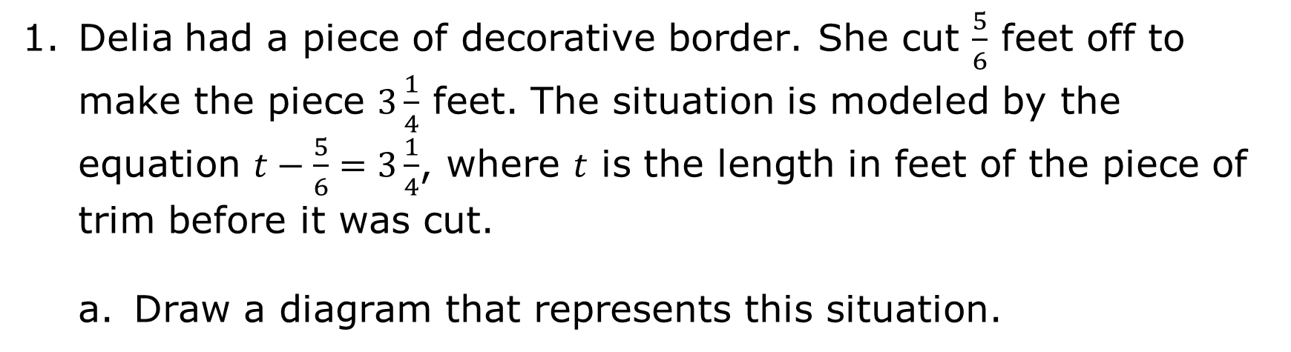
12.2.5 Your Turn!
Delia had a piece of decorative border. She cut $\frac{5}{6}$ feet off to make the piece $3\frac{1}{4}$ feet. The situation is modeled by the equation $t−\frac{5}{6}=3\frac{1}{4}$, where 𝑡 is the length in feet of the piece of trim before it was cut.
Draw a diagram that represents this situation.
volume 2, pg. 292

Slide 27
How long was the piece of border before Delia cut it? Include units.
volume 2, pg. 292

Slide 28

Wrap-Up
volume 2, pg. 292

Slide 29
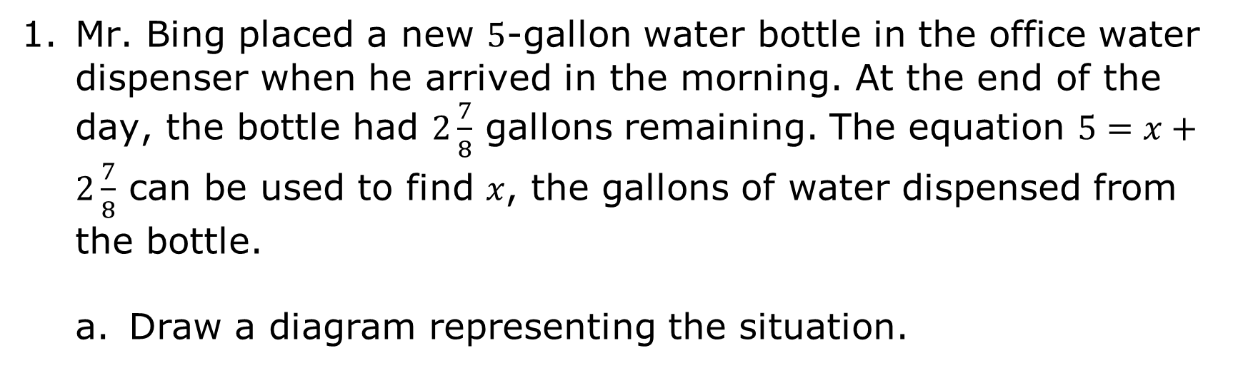
12.2.6 Wrap-Up: Ticket Out the Door
Mr. Bing placed a new $5$-gallon water bottle in the office water dispenser when he arrived in the morning. At the end of the day, the bottle had $2\frac{7}{8}$ gallons remaining. The equation $5=x+2\frac{7}{8}$ can be used to find 𝑥, the gallons of water dispensed from the bottle.
Draw a diagram representing the situation.
volume 2, pg. 292

Slide 30
How much water was dispensed from the bottle? Include units.
volume 2, pg. 292

